Slide 1

Network Layer: Supernetting
Computer Communication and Networks
Session 12
Tutor: Karma Wangchuk

Slide 2

Network Layer
Learning Outcome:- At the end of the lesson, you are expected to be able to:
  Supernetting
  Advantages of supernetting
  Finding summarize route

Slide 3
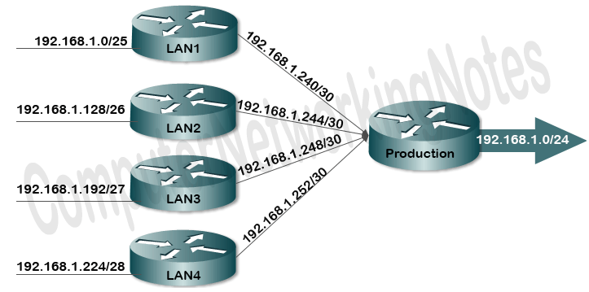
Network Layer: Supernetting
Supernetting
  What is Supernetting?
    Supernetting is the process of summarizing a bunch of contiguous Subnetted networks back in a Single large networks.
  Supernetting is also known as route summarization and route aggregation.
  8 subnets are summarized
  in single subnet

Slide 4
Network Layer: Supernetting
Supernetting
  Why Supernetting is done?
    Supernetting is mainly done for optimizing the routing tables.
      A routing table is the summary of all known networks.
      Routers share routing tables to find the new path and locate the best path for the destination.
    Without Supernetting, the router will share all routes from routing tables as they are.
    With Supernetting, it will summarize them before sharing.
    Route summarization reduces the size of routing updates dramatically.

Slide 5
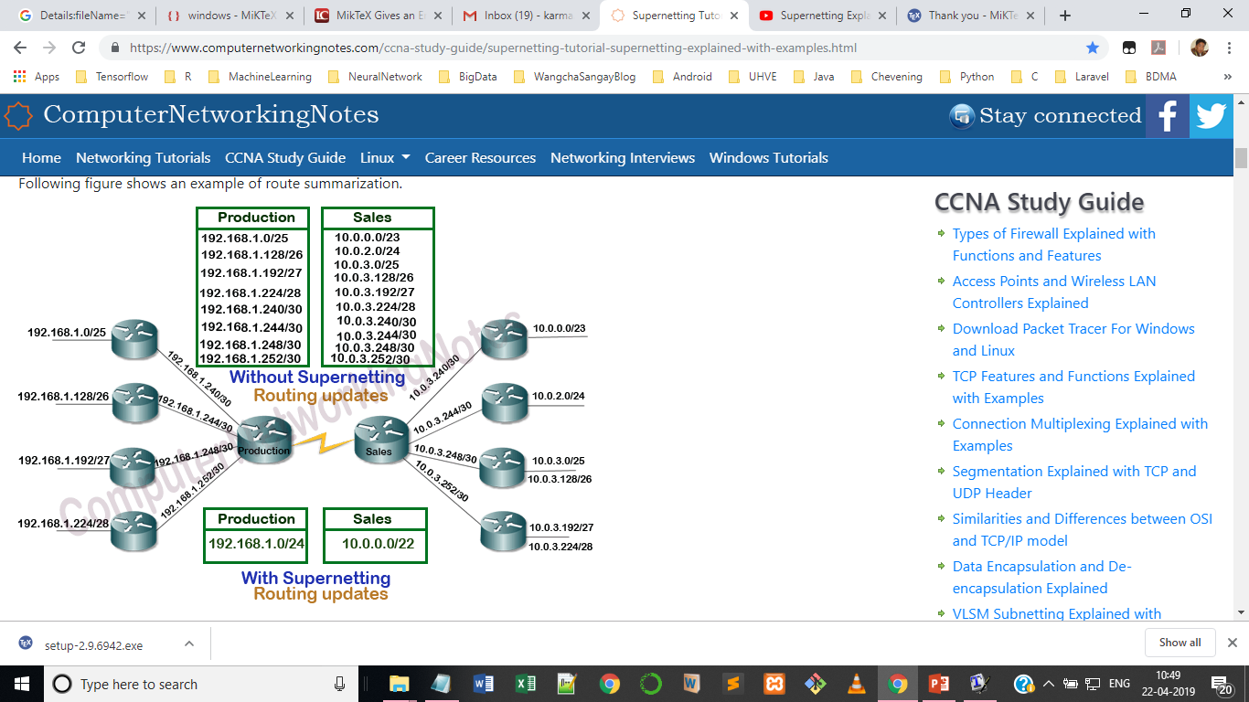
Network Layer: Supernetting
Supernetting: Routing Table

Slide 6
Network Layer: Supernetting
Supernetting
  Advantages of Supernetting:
    It reduces the size of routing updates.
    It provides a better overview of network.
    It decreases the use of resources such as Memory and CPU.
    It decreases the required time in rebuilding the routing tables.

Slide 7
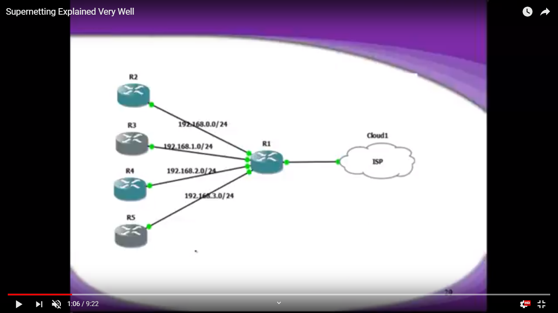
Network Layer: Supernetting
Supernetting: Example 1
What is the summarize route?
x.y.z.t/n ???

Slide 8
Network Layer: Supernetting
Supernetting: What is Summarize Route?
  Steps to find the summarize route:
    Write all the numbers to Binary
    Find matching bits left to right upto match
    Write upto match and "0" upto end (New NID)
    Mark all "1" upto match and zero upto end (New Mask)

Slide 9
Network Layer: Supernetting
Supernetting
  Networks:
  Steps to find the summarize route:
    1. Write all the numbers to Binary
192.168.0.0/24
192.168.1.0/24
192.168.2.0/24
192.168.3.0/24
11000000.10101000.00000000.00000000
11000000.10101000.00000001.00000000
11000000.10101000.00000010.00000000
11000000.10101000.00000011.00000000

Slide 10
Network Layer: Supernetting
Supernetting
  2. Find matching bits left to right upto match
  3. Write upto match and "0" upto end (New NID)
  11000000.10101000.00000000.00000000 or 192.168.0.0
11000000.10101000.00000000.00000000
11000000.10101000.00000001.00000000
11000000.10101000.00000010.00000000
11000000.10101000.00000011.00000000
11000000.10101000.00000000.00000000
11000000.10101000.00000001.00000000
11000000.10101000.00000010.00000000
11000000.10101000.00000011.00000000

Slide 11
Network Layer: Supernetting
Supernetting
4. Mark all "1" upto match and zero upto end (New Mask)
    11111111.11111111.11111100.00000000 or /22
    Therefore, the summarized route for the networks is
    192.168.0.0/22
11000000.10101000.00000000.00000000
11000000.10101000.00000001.00000000
11000000.10101000.00000010.00000000
11000000.10101000.00000011.00000000
192.168.0.0/24
192.168.1.0/24
192.168.2.0/24
192.168.3.0/24

Slide 12
Network Layer: Supernetting
Supernetting: Example 1
What is the summarize route?
192.168.0.0/22

Slide 13
Network Layer: Supernetting
Supernetting: Components
  Each route advertises a certain number of addresses including network ID, broadcast ID and subnet mask.
    We can use a term Block size to refer all these addresses collectively.
  In order to perform the Supernetting, following information is required:
    Network ID
    CIDR Value
    Broadcast ID
    Subnet Mask
    Block Size of each route.

Slide 14
Network Layer: Supernetting
Supernetting: Components
  Network ID and broadcast ID are used to check the alignment of routes.
      Supernetting can be performed only if routes are sequential.
  Block size is used to calculate the summarized route from given routes.
  Subnet mask and CIDR value is the same thing in different notations.
      Both are used to find the ON network bits in IP address.
  Since an advertise route is the combination of network ID and CIDR value, we only need to figure out the broadcast ID, subnet mask and block size.

Slide 15
Network Layer: Supernetting
Supernetting: Components
  32 – CIDR Value = Number of host bits
  Block size = 2^{Number of host bits}
  For example if CIDR value is 25 then block is 128.
    32 -25 = 7
    2⁷ = 128
  For example if network ID is 192.168.1.0/25. What is block size and broadcast ID?

Slide 16
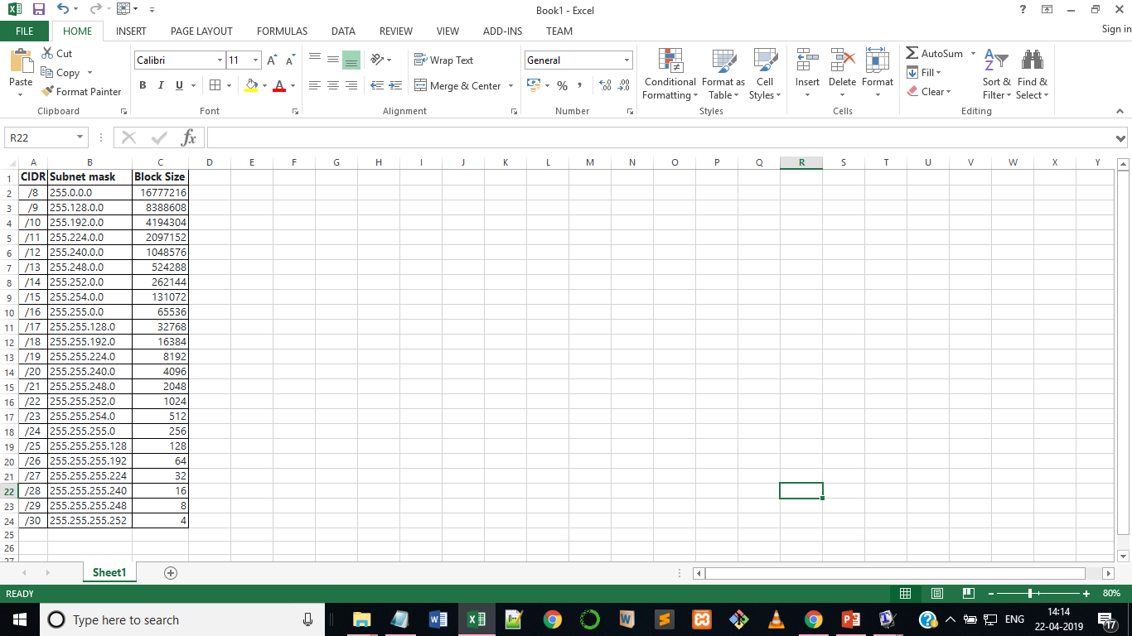
Network Layer: Supernetting
Supernetting: Components

Slide 17
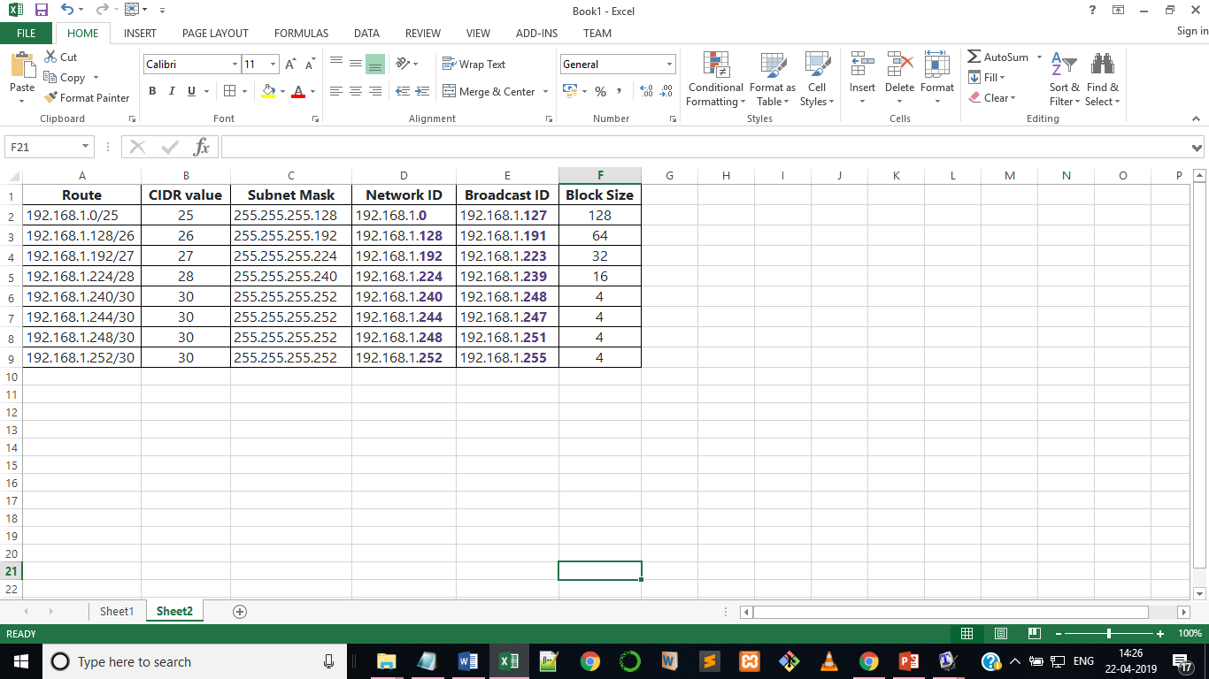
Network Layer: Supernetting
Supernetting
  Supernetting can be done
  only in the same address space.
  If address space is completely different between two or more routes, they CANNOT be summarized in a single route.
  For example, we can’t summarize the route 192.168.1.0/25 with the route 193.168.1.128/25

Slide 18
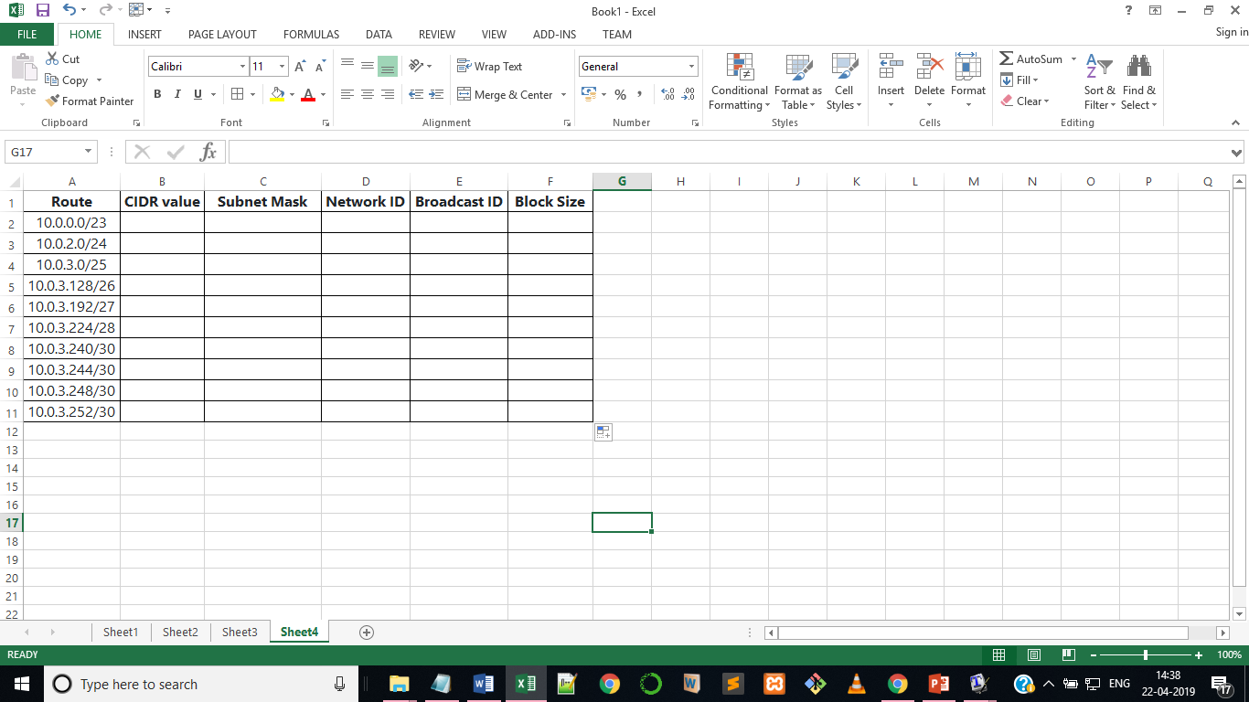
Network Layer: Supernetting
Supernetting
  Find missing values in the table given below:

Slide 19
References
References:
  Stallings, W., Data & Computer Communication, Prentice-Hall
  Tanenbaum, Computers Networks, PHI
  Forouzan, B.A., Data Communication & Networkings, 4th Edition.
  Mr. Yeshi Wangchuk’s CCN Class Slides (2014), College of Science and Technology, Rinchending, Phuentsholing, Bhutan
  https://www.computernetworkingnotes.com/ccna-study-guide/supernetting-tutorial-supernetting-explained-with-examples.html

